Slide 1
The Economic Dynamics Of Hosting FIFA World Cup
A Comparative Study of Developed and Developing Nations

Slide 2
Researchers:
Areeba Naeem (231236) Iqra Hussain (231222) Alishba Adnan (231184)
Department of Creative Technologies, Air University
Supervisor: Prof. Tahir Sher

Slide 3
TABLE OF CONTENTS
01
LITERATURE REVIEW
02
RESEARCH METHODOLOGY
03
DISCUSSIONS
04
Developed Vs. Developing
Comparative Insights
Developed Vs. Developing
Comparative Insights
CONCLUSION
Developed Vs. Developing
Key Points
Final Thought

Slide 4
INTRODUCTION
BACKGROUND
The FIFA World Cup, established in 1930 under the vision of Jules Rimet, has evolved into the pinnacle of global sports, captivating billions worldwide.
It is not just a football tournament; it serves as a grand stage where nations showcase their ambitions, infrastructure, and economic might.
Iconic moments, such as Brazil's dominance in 1970 and South Africa's historic hosting in 2010, highlight its significance.
However, beneath the glory and celebration lies a complex narrative involving financial investment, economic transformation, and varied long-term legacies for both developed and developing nations.
PROBLEMS IDENTIFIED
How do advanced economies like Germany benefit economically from their established infrastructure?
Why do emerging nations like Brazil or South Africa invest heavily for the promise of global recognition?

Slide 5
INTRODUCTION
IMPORTANCE OF THE RESEARCH
Hosting the FIFA World Cup can drastically alter a nation's global image, economy, and infrastructure.
Understanding the economic dynamics and consequences of hosting the event is crucial for future hosts to maximize benefits and avoid pitfalls.
This research sheds light on the economic winners and losers, offering insights for making the World Cup a sustainable and transformative opportunity.
OBJECTIVES
Compare the opportunities and challenges of hosting the World Cup for developed and developing countries.
Analyze factors such as infrastructure investment, tourism surges, job creation, and post-event economic sustainability.

Slide 6
01
LITERATURE REVIEW
Lessons from Brazil, Germany, South Africa, and Japan

Slide 7
Economic Impacts of Hosting the FIFA World Cup in Developing Countries
Short-term Benefits:
Significant influx of tourists.
Temporary job creation.
Immediate economic boost and global visibility.
Long-term Challenges:
Substantial financial liabilities and debt.
Underutilized facilities and "white elephant" stadiums.
Persistent social unrest and public dissatisfaction.
Governance and Public Perception:
Misallocation of resources and funds.
Lack of transparent governance.
Public protests and criticism.
Environmental Practices:
Poor environmental practices and sustainability issues.
Criticism for not implementing eco-friendly measures

Slide 8
Economic Impacts of Hosting the FIFA World Cup in Developed Countries
Short-term Benefits:
Significant influx of tourists.
Immediate economic boost and increased international visibility.
Temporary job creation.
Long-term Benefits:
Enhanced infrastructure and efficient utilization of new facilities.
Sustained growth in tourism and international trade.
Positive global branding and improved international reputation.
Governance and Public Perception:
Effective resource management and strategic planning.
High public trust in government and event management.
Fewer controversies and public protests.
Environmental Practices:
Implementation of sustainable and eco-friendly measures.
Recognition for green practices and environmental responsibility.

Slide 9
Comparative Insights and Broader Lessons
How Our Research Addresses These Gaps
Key Studies
Gaps in Existing Research
Comparative studies on economic dynamics, infrastructure, and social challenges across different hosts.
Limited comparative analysis of developed vs. developing nations' experiences.
Insufficient focus on strategic planning and community inclusion.
Provides a comparative analysis of economic, infrastructure, and social impacts across multiple hosts.
Offers actionable insights for strategic planning, community inclusion, environmental responsibility, and transparent governance for future FIFA World Cup hosts.

Slide 10
02
RESEARCH METHODOLOGY
Developed vs. Developing Countries

Slide 11
Developed Countries (Japan and Germany)
Approach: Quantitative analysis with pre- and post-event comparison.
Data Collection:
Japan:
GDP Growth Rate (1998-2001): 0.1%-1.5%
Unemployment Rate: ~5.4%
Total Investment in Event: $5 Billion
Germany :
GDP Growth Rate (2003-2006): 33% Increase (from approximately $592 billion in Q1 2003 to nearly $800 billion by Q4 2006). Quarterly Growth: 2.8% to 5.0% in 2006
Unemployment Rate: For every 0.1% increase in unemployment, GDP decreased by approximately $1.1 billion per quarter
Total Investment:
Infrastructure Investment: $255.14 billion per quarter
Stadium Investment: Negative impact, with GDP decreasing by approximately $201 billion per quarter per billion dollars spent
Key Variables:
Infrastructure development
Tourism revenue
Technological advancements
Strategic planning

Slide 12
Developing Countries (South Africa and Brazil)
Approach: Quantitative analysis focusing on economic impacts before, during, and after the event.
Data Collection:
South Africa:
GDP Growth Rate (2006-2009): 2.8%-5.4%
Unemployment Rate: ~25%
Total Investment in Event: $3.6 Billion
Brazil :
GDP Growth(2011 – 2016):GDP declined from $2.6 trillion in 2011 to just over $1.7 trillion by 2016, a decrease of more than 30% in five years. Quarterly GDP Growth: Once positive and reaching 2.3% pre-2014, plummeted to negative territory post-World Cup, ranging from -0.1% to -2.2%.
Unemployment Rate
Impact on GDP: The coefficient for unemployment reflects a peculiar relationship, potentially distorted by its high correlation with inflation.
Total Investment
Investment in Infrastructure: For every $1 billion spent on general infrastructure projects, Brazil’s GDP decreased by nearly $52 billion per quarter.
Investment in Stadiums: Statistically significant variable indicating high correlations between independent variables, contributing to inefficiencies in resource allocation.
Key Variables:
Infrastructure development
Tourism revenue
Job creation
Social and economic challenges

Slide 13
Comparative Analysis
Economic Impacts: Developed Nations: Sustained long-term economic benefits, strategic use of existing infrastructure Developing Nations: Short-term boosts but long-term financial and social challenges Governance and Sustainability: Developed Nations: Effective governance, fewer controversies, sustainable practices Developing Nations: Public protests, resource misallocation, environmental criticism

Slide 14
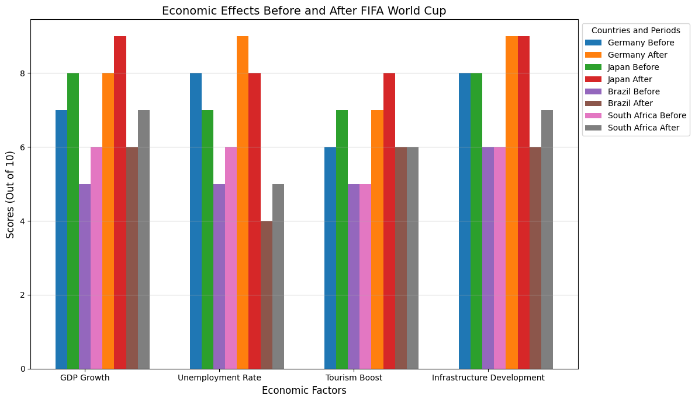
Economic Effects Before and After FIFA World Cup

Slide 15
03
DISCUSSIONS

Slide 16
Developed Nations (Japan, Germany) Leveraged existing infrastructure and strong governance. Achieved long-term benefits in tourism and economic growth. Developing Nations (Brazil, South Africa) Experienced short-term boosts. Faced long-term challenges like debt, social unrest, and underused facilities. Key Points Strategic planning and firm governance lead to success. Poor planning results in financial and social issues. Sustainable practices and transparent governance are crucial for lasting benefits.

Slide 17
04
CONCLUSIONS

Slide 18
Stability and Success
Japan and Germany: Leveraged strong infrastructure and governance for sustained economic benefits and global branding.
Challenges of Hosting
Brazil and South Africa: Achieved short-term boosts but faced long-term issues like debt, social unrest, and underutilized facilities.
Blueprint for Future Success
Strategic Vision: Align event with national development plans.
Transparent Governance: Ensure strong accountability and resource management.
Eco-Responsibility: Implement sustainable practices to minimize environmental impact.
Final Thought
Balanced Approach: Combining strategic planning, governance, and sustainability can transform the FIFA World Cup into a catalyst for lasting positive change.

Slide 19
THANK YOU
END

